Slide 1
Android App Development
For Start-ups

Slide 2


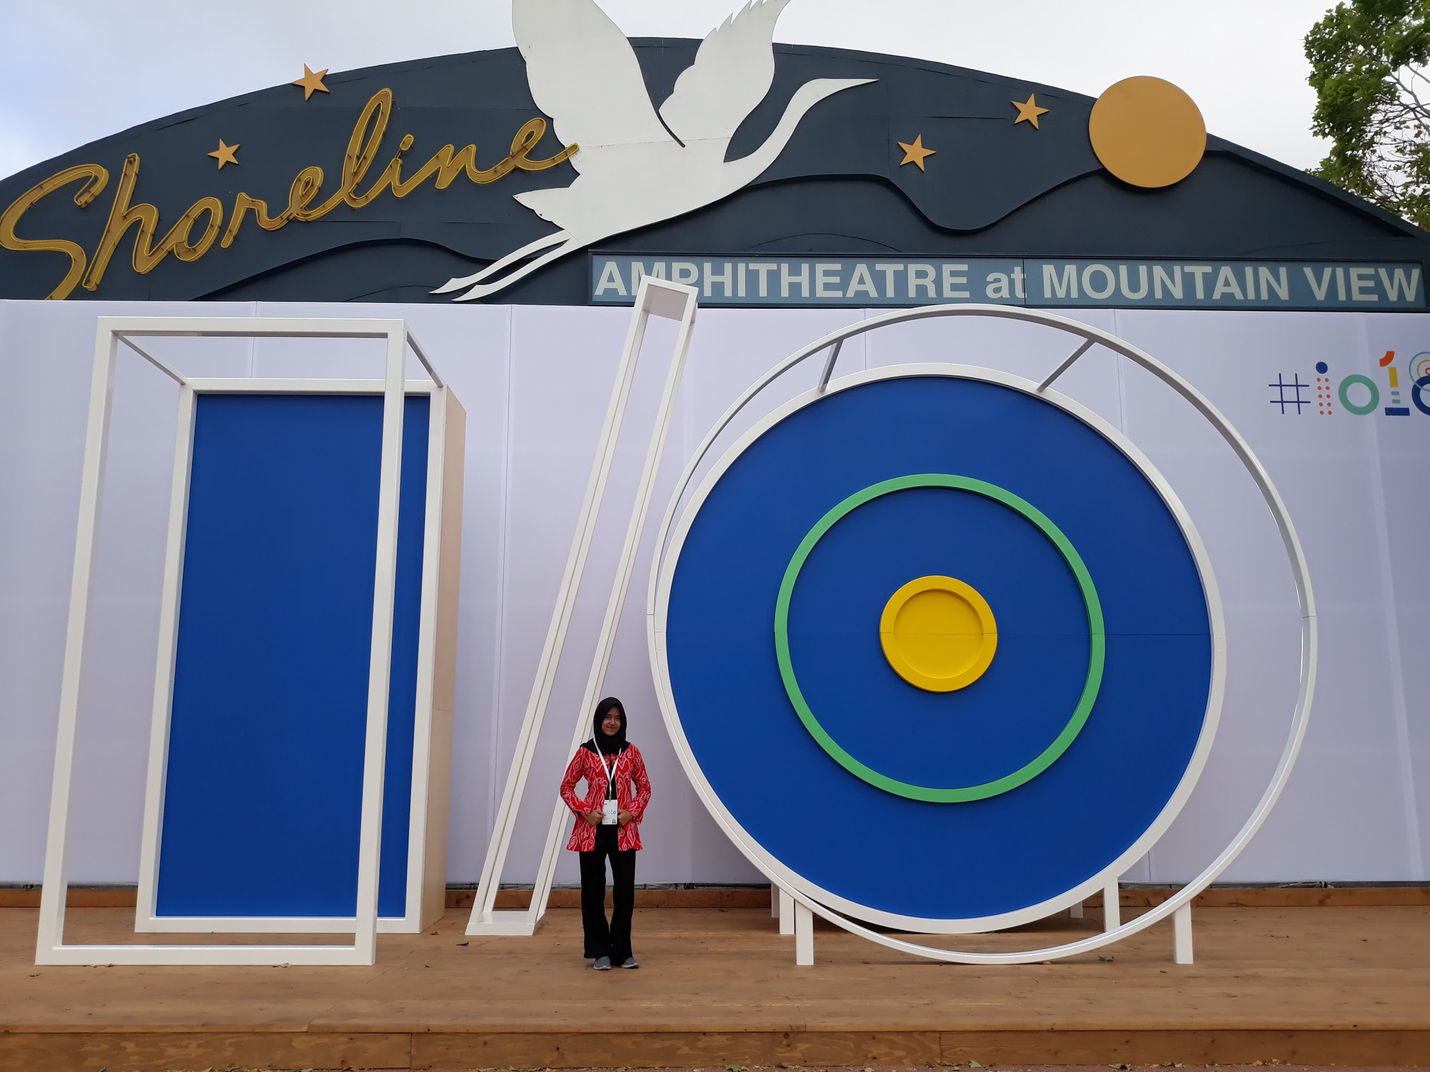







Introduction
Annisa Nurul A
Teknik Informatika ITB’15

Slide 3




Slide 4

Notes:
Perusahaan rintisan, umumnya disebut startup (atau ejaan lain yaitu start-up), merujuk pada semua perusahaan yang belum lama beroperasi.

Slide 5
StartUp
Usia perusahaan kurang dari 3 tahun
Jumlah pegawai kurang dari 20 orang
Pendapatan kurang dari $ 100.000/tahun
Masih dalam tahap berkembang
Umumnya beroperasi dalam bidang teknologi
Produk yang dibuat berupa aplikasi dalam bentuk digital
Characteristics

Slide 6

Notes:
Mobile operating system based on Linux kernel
User Interface for touch screens
Used on over 80% of all smartphones
Powers devices such as watches, TVs, and cars
Over 2 Million Android apps in Google Play store
Highly customizable for devices / by vendors
Open source

Slide 7
Tips & Tricks

Slide 8
Tips #1
Focus to develop the one feature that makes your app unique
Prioritize, focus on important features

Slide 9
Tips #2
Mockup
Application flow
User Interface and User Experience
Design Your App

Slide 10
Tips #3
Define technology stack and tools
Choose an app architecture (MVC, MVP, MVVM, etc.)
Clean Code
SDLC -> Iterative, Agile, etc.
Develop Your App

Slide 11
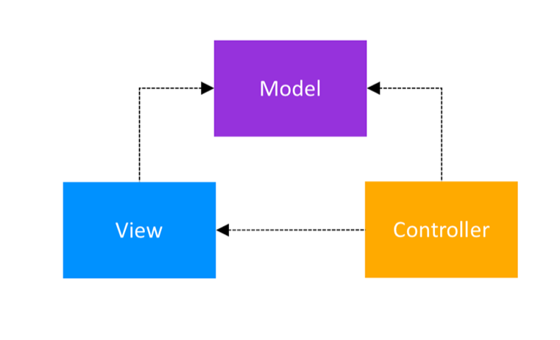
MVC

Slide 12
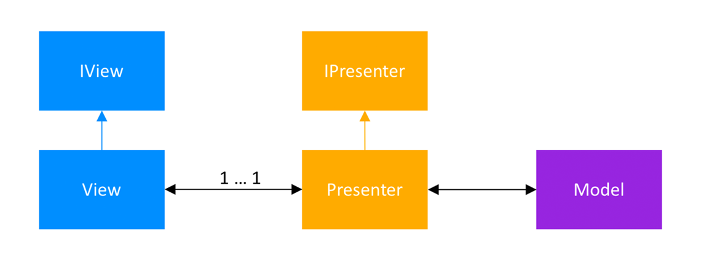
MVP

Slide 13
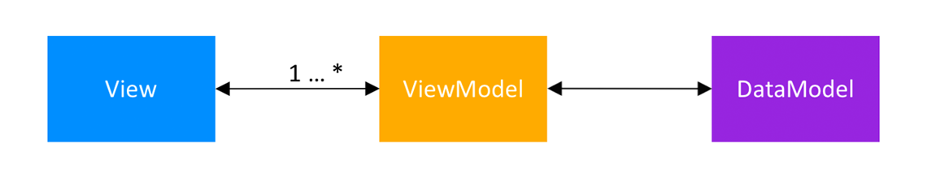
MVVM

Slide 14
Tips #4
Stay updated about the latest technology to maintain and improve our app
Keep updated

Slide 15
Misc Session :D

Slide 16
Terima kasih

